Slide 1
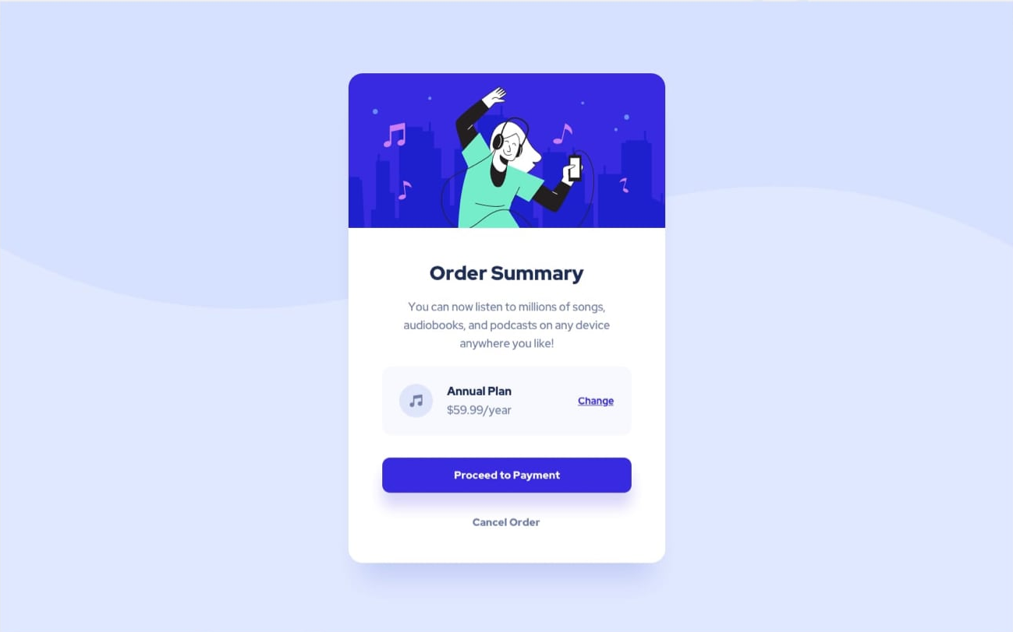
PROJECT ONE : ORDER SUMMARY CARD

Slide 2
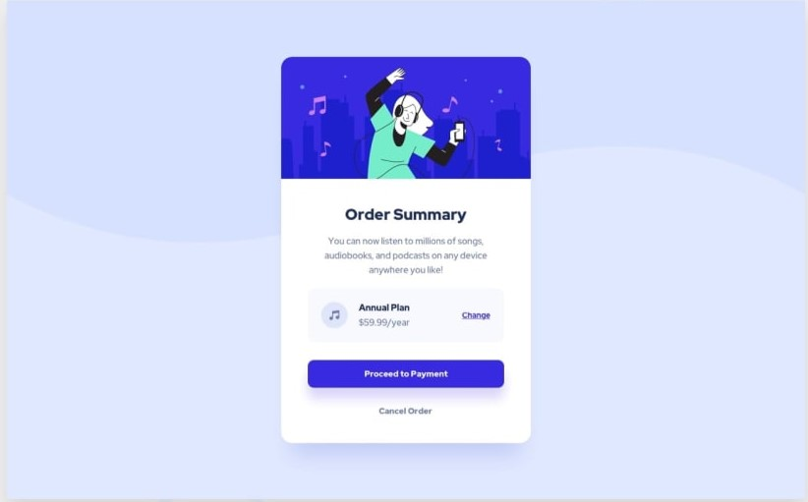
PLANNING: EXTRACTING COMPONENTS
Container
Card

Slide 3
EXTRACTING CARD COMPONENTS
Card-header
Card-body

Slide 4
Card Header Component
Card-image-top

Slide 5
Card Body Components
Card-heading
Card-text
Card-pricing
Card-btn-payment
Card-btn-cancel

Slide 6
TRANSFORMING COMPONENTS TO CODE
BLANK HTML STARTER CODE
<!DOCTYPE html>
<html lang="en">
<head>
<meta charset="UTF-8" />
<meta http-equiv="X-UA-Compatible" content="IE=edge" />
<meta name="viewport" content="width=device-width, initial-scale=1.0" />
<title>ORDER SUMMARY CARD</title>
</head>
<body>
</body>
</html>

Slide 7
TRANSFORMING COMPONENTS TO CODE
<div class="container">
</div>
Container
<div class=“card">
</div>
Card

Slide 8
What is a div
The <div> tag defines a division or a section in an HTML document.
The <div> tag is used as a container for HTML elements - which is then styled with CSS or manipulated with JavaScript.
The <div> tag is easily styled by using the class or id attribute.
Any sort of content can be put inside the <div> tag!

Slide 9
EXTRACTING CARD COMPONENTS
<div class="container">
</div>
Card-header
<div class=“card">
</div>
<div class=“card-header">
</div>
Card-body
<div class=“card-body">
</div>

Slide 10
Card Header Component
<div class=“card-header">
</div>
We will Use Css to add the image
Card-image-top

Slide 11
Codding Challenge #01
Try writing code for Card components

Slide 12
Margin : 20px (tb) 30px(rl)

